Slide 1
CLASSIFICATION ALGORITHMS Instance Based Learning Naive Bayes

Slide 2
NAIVE BAYES
A statistical classifier: performs probabilistic prediction, i.e., predicts class membership probabilities.
Foundation: Based on Bayes’ Theorem.
Given training data X, posteriori probability of a hypothesis H, P(H|X), follows the Bayes theorem

Slide 3
NAIVE BAYES
X = (age <= 30 , income = medium, student = yes, credit_rating = fair)
P(C₁): P(buys_computer = “yes”) = 9/14 = 0.643
P(C₂): P(buys_computer = “no”) = 5/14= 0.357
Compute P(X|C_{i}) for each class
P(age = “<=30” | buys_computer = “yes”) = 2/9 = 0.222
P(age = “<= 30” | buys_computer = “no”) = 3/5 = 0.6
P(income = “medium” | buys_computer = “yes”) = 4/9 = 0.444
P(income = “medium” | buys_computer = “no”) = 2/5 = 0.4
P(student = “yes” | buys_computer = “yes) = 6/9 = 0.667
P(student = “yes” | buys_computer = “no”) = 1/5 = 0.2
P(credit_rating = “fair” | buys_computer = “yes”) = 6/9 = 0.667
P(credit_rating = “fair” | buys_computer = “no”) = 2/5 = 0.4
P(X|C₁) : P(X|buys_computer = “yes”) = 0.222 x 0.444 x 0.667 x 0.667 = 0.044
P(X|C₂) : P(X|buys_computer = “no”) = 0.6 x 0.4 x 0.2 x 0.4 = 0.019
P(X|C_{i})*P(C_{i}) : P(X|buys_computer = “yes”) * P(buys_computer = “yes”) = 0.028
P(X|buys_computer = “no”) * P(buys_computer = “no”) = 0.007
Therefore, X belongs to class (“buys_computer = yes”)

Slide 4
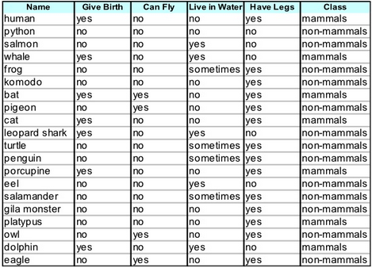

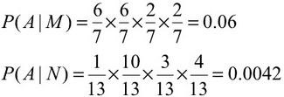
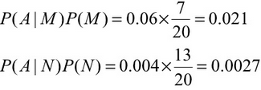

NAIVE BAYES

